Slide 1
The Index of coincidence
James Cogswell
CYSE 476

Slide 2
Introduction
Introduced in 1922 – William Friedman
Statistical evaluation of the repeated occurrence of characters in cipher text
Identifies transposition and monoalphabetic substitution as well as polyalphabetic substitution ciphers
Estimate the key length of a polyalphabetic substitution cipher
Dramatically simplifies ciphers like Vigenère, while knowing only the cipher

Slide 3
Key Points to Remember
IC values range from
Non-Normalized: ~0.038 - ~0.0665
English Normalized: ~1 - ~1.73
This is simply the non-normalized number * 26 English characters
Lower IC represents more randomized text and signals that a polyalphabetic substitution cipher was used; i.e., every letter has roughly equal probability of appearance
Higher IC represents frequency distributions closer to that of plaintext, and therefore suggests that a transposition or monoalphabetic substitution cipher was used; i.e., frequency distribution of characters will reflect that of the language used

Slide 4

Equation
$$IC=c ×\left(\frac{n_{a}}{N}×\frac{n_{a}−1}{N−1}\right)+\left(\frac{n_{b}}{N}×\frac{n_{b}−1}{N−1}\right)+…+\left(\frac{n_{z}}{N}×\frac{n_{z}−1}{N−1}\right)$$
$$= \frac{\sum_{i=1}^{c}{n_{i}(n_{i}−1)}}{\frac{N\left(N−1\right)}{c}}$$
Where…
c is the normalizing coefficient
$n_{a}$ (represented by $n_{i=1}$) is the # of times the letter ‘a’ appears in the cipher text
N is the length of the ciphertext
i refers to the numerical representation of each letter in the alphabet [a=1, b=2, …, z=26]

Slide 5
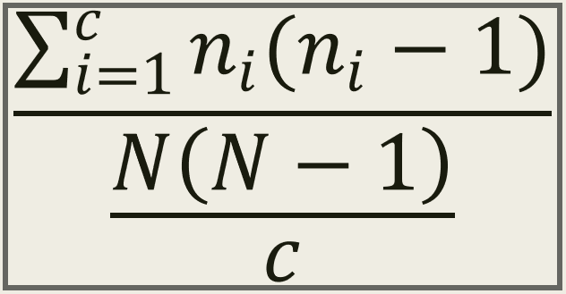
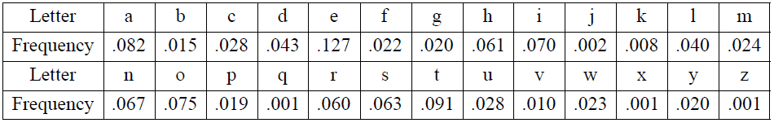
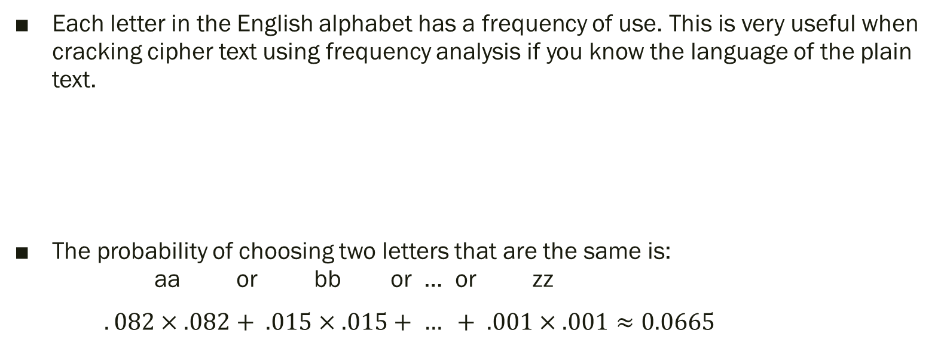
English Letter Frequencies
Each letter in the English alphabet has a frequency of use. This is very useful when cracking cipher text using frequency analysis if you know the language of the plain text.
The probability of choosing two letters that are the same is: aa or bb or … or zz
$.082×.082+ .015×.015+ … + .001×.001≈0.0665$
Do you see why an IC close to
0.0665 suggests that it was
encrypted with a monoalphabetic
substitution or transposition
cipher?

Slide 6
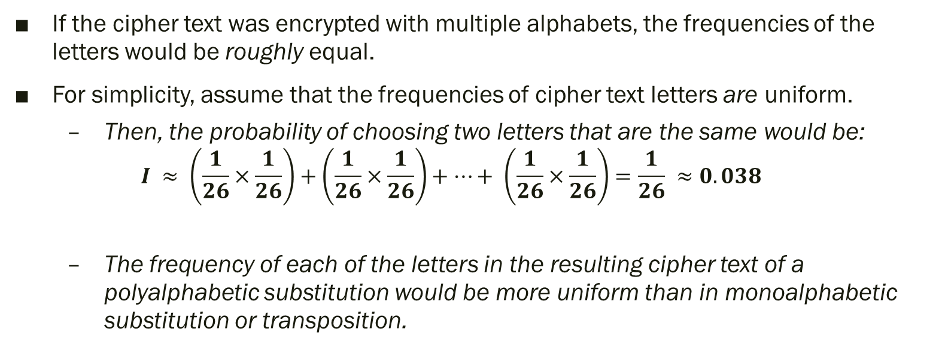
Random Text
If the cipher text was encrypted with multiple alphabets, the frequencies of the letters would be roughly equal.
For simplicity, assume that the frequencies of cipher text letters are uniform.
Then, the probability of choosing two letters that are the same would be:
$$I ≈ \left(\frac{1}{26}×\frac{1}{26}\right)+\left(\frac{1}{26}×\frac{1}{26}\right)+…+ \left(\frac{1}{26}×\frac{1}{26}\right)=\frac{1}{26} ≈0.038$$
The frequency of each of the letters in the resulting cipher text of a polyalphabetic substitution would be more uniform than in monoalphabetic substitution or transposition.

Slide 7
Frequency Graphs
When examining cipher text, it is often useful to calculate the frequencies of each letter and plot them on a bar graph
Graphs that have peaks and valleys tend to be encrypted with monoalphabetic substitution or transposition ciphers since the frequencies are preserved
If the graph more closely resembles a uniform distribution, then it is likely that the cipher is polyalphabetic substitution

Slide 8
Example [1]
Let’s examine the frequency distribution for the plaintext (XX used for padding):
MUST CHANGE MEETING LOCATION FROM BRIDGE TO UNDERPASS SINCE ENEMY AGENTS ARE BELIEVED TO HAVE BEEN ASSIGNED TO WATCH BRIDGE STOP MEETING TIME UNCHANGED XX
Cipher text produced by the Vigenère cipher and key=EVERY:
QPWKALVRXCQZIKGRBPFAEOMFLJMSDZVDHXCXJYEBIMTRQWNMEAIZRVKCVKVLXNEICFZPZCZZHKMLVZVZIZRRQWDKECHOSNYXXLSPMYKVQXJTDCIOMEEXDQVSRXLRLKZHOV
Cipher text produced by the Affine cipher and key a=5 and b=8:
QEUZSRIVMCQCCZWVMLASIZWAVHPAQNPWXMCZAEVXCPFIUUUWVSCCVCQYIMCVZUIPCNCLWCJCXZARIJCNCCVIUUWMVCXZAOIZSRNPWXMCUZAFQCCZWVMZWQCEVSRIVMCXTT

Slide 9
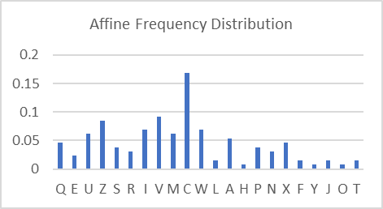
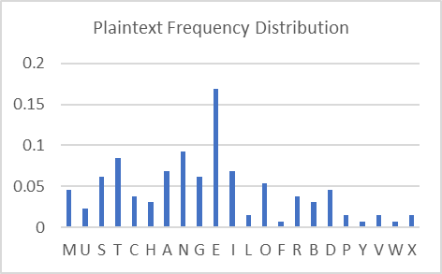
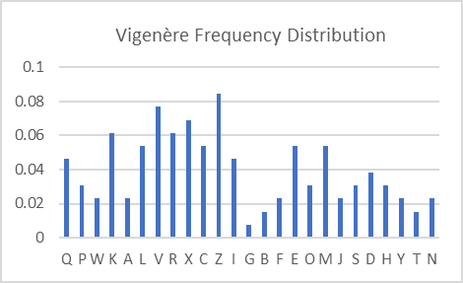
Example [1] continued…
Graphs of the letter frequency distribution
Notice the similarities between the Affine cipher and the plain text distributions? If the cipher text was longer, then the Vigenère would more closely resemble a normal distribution.

Slide 10
Example [2]
I wrote a Python program that will either take a cipher text as user input or use one that is already programmed in which will find the IC for the entire cipher text as well as estimate the key length.
Remember:
0.038 (~1.0) suggests monoalphabetic or transposition cipher
0.0665 (~1.73) suggests transposition cipher
Using the same Vigenère cipher text as before:
QPWKALVRXCQZIKGRBPFAEOMFLJMSDZVDHXCXJYEBIMTRQWNMEAIZRVKCVKVLXNEICFZPZCZZHKMLVZVZIZRRQWDKECHOSNYXXLSPMYKVQXJTDCIOMEEXDQVSRXLRLKZHOV
…we will explore how the program works.

Slide 11
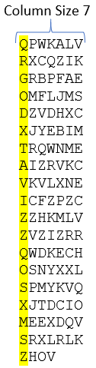
Example [2] continued… Guessing the Key Length
Guess a column size. For example, 7.
Create new strings from each column
Column 1: QRGODXTAVIZZQOSXMSZ
Column 2: PXRMZ…
Column 3: WCBFV…
and so on…
Compute the IC of each column’s string of characters
Sum up all these individual ICs and divide by the # of columns
Repeat this for different column sizes and put them in a table

Slide 12
Example [2] continued…
If you incorrectly guessed the key length, then the average IC of the columns will be low; closer to 1.0 (normalized)
The column size(s) with the highest average IC are likely the length of the key or a multiple of the length
If the key length is 3, then columns of size 3, 6, 9… will all have higher ICs

Slide 13
Example [2] continued…
Results from the program…
Average IC for Column Size 1: 0.04293 (1.116)
Average IC for Column Size 2: 0.04567 (1.188)
Average IC for Column Size 3: 0.04030 (1.048)
Average IC for Column Size 4: 0.04494 (1.168)
Average IC for Column Size 5: 0.07015 (1.824)
Average IC for Column Size 6: 0.03810 (0.990)
Average IC for Column Size 7: 0.03872 (1.007)
Average IC for Column Size 8: 0.04032 (1.048)
Average IC for Column Size 9: 0.04518 (1.175)
Average IC for Column Size 10: 0.07949 (2.067)
The key size for this cipher is most likely 5

Slide 14

Example [2] continued…
Why?
Because once you’ve identified the correct key length, then every letter in that string will have been encrypted using the same letter of the key.
Now we’re dealing with a much simpler shift cipher.
The only thing left to do now is break the Caesar Shift cipher! You can perform that one on your own. Friedman’s IC ends here.

Slide 15
Modern Uses
The Index of Coincidence was created during a time when computer encryption was not the focus of this method.
However, data encrypted with the Vigenère cipher, for example, can also be broken using the index of coincidence – even at the binary level.
So long as we know the cipher text is a binary representation of a known alphabet, then the Index of Coincidence can be used.

Slide 16
Index of Coincidence and Kasiski Examination
Kasiski Examination is another method of finding the length of the encryption key
First, find every repeated set of at least three characters in the cipher text
Example [3]:
Plaintext: THE CAT IS OUT OF THE BAG
Key: SPILLTHEBEANS

Slide 17
Example [3] continued…
The repeated characters could be the same plain text characters that were encrypted using the same subkeys of the Vigenère key
PT: THECATISOUTOFTHEBAG
K : SPILLTHEBEANSSPILLT
CT: LWMNLMPWPYTBXLWMMLZ
Notice how the letters ‘LWM’ are repeated twice in the cipher text

Slide 18
Example [3] continued…
The plain text letters “THE” were encrypted using the same letters from the key “SPI”
The number of letters from the beginning of the first “LWM” to the beginning of its second appearance is 13. This is known as the spacing
The spacing is what tells us the length of our key, like how the column sizes with the largest IC worked in the previous example

Slide 19
Example [3] continued…
Bad news: the key won’t always perfectly align with repeated sequences of letters
or the key could repeat several times between the repeated sequences.
This means that the # of characters between the repeated sequences could be a multiple of the actual key length!
With longer cipher texts, it becomes more likely that the spacing will more accurately reflect the key length.
Take this example from the book “Cracking Codes with Python: an Introduction to Building and Breaking Ciphers”…

Slide 20
Example [3] continued…
48 Characters
8 Characters
24 Characters
PPQCAXQVEKGYBNKMAZUYBNGBALJONITSZMJYIMVRAGVOHTVRAUCTKSGDDWUOXITLAZUVAVVRAZCVKBQPIWPOU
The spacing between these repeated sequences are all useful to us in finding the actual key length
8 Characters
32 Characters

Slide 21
Example [3] continued…
There are spacings of 48 letters, 32 letters, 24 letters, and 8 letters
Factor each of these spacings and count the appearance of the factors
(4x) 2
(4x) 4
(2x) 6
(4x) 8
(2x) 12
(1x) 16
(2x) 24
(1x) 48
Spacing | Factors
8 | 2, 4, 8
24 | 2, 4, 6, 8, 12, 24
32 | 2, 4, 8, 16
48 | 2, 4, 6, 8, 12, 24, 48
Our most common factors are 2, 4, and 8

Slide 22
Example [3] continued…
Perform the same columnar type of setup as explained earlier, but this time only set them up in columns of size 2, 4, and 8 (our most common factors)
Note: you can perform the index of coincidence here, but since we’re reviewing an alternative method to finding the key length, we’ll skip that part
Use the key length of 4 and try to crack the resulting cipher text. No luck? Try it with 2 and 8!
This works similarly to how it worked in the previous example; if you choose the correct key length, then each letter of each column will have been encrypted by the same subkey
Now we are once again dealing with a simple shift cipher

Slide 23
Example [3] continued…
Alternative to the Index of Coincidence, you can run frequency analysis on the columns
The correct key size will more closely reflect the frequency distribution of the language in which the plain text was written
For those who are wondering, the most likely subkeys were
Column 1: A, I, N, W, X
Column 2: I, Z
Column 3: C
Column 4: K, N, R, V, Y
Combine these possible subkeys in every way possible. You will find that the key is ‘WICK’ and the plaintext is ‘THOSEPOLICEOFFICERSOFFEREDHERARIDEHOMETHEYTELLTHEMAJOKETHOSEBARBERSLENTHERALOTOFMONEY’

Slide 24
Wrapping Up…
Encryption has and always will change throughout time so long as the methods to break them continue improving
Once upon a time, the Caesar shift was considered secure enough so that a message could be sent without the enemy being able to make sense of it
Polyalphabetic substitution ciphers such as the Vigenère cipher were much more complex and eventually rendered useless
Even our encryption standard AES-256 has a limited life span as computer technology grows exponentially
However, the index of coincidence can still be used today and is considered by some to be a foundational concept in cryptography

Slide 25
Questions?

Slide 26
References
[1] A. Sweigart, Cracking Codes with Python: An Introduction to Building and Breaking Ciphers. William Pollock, 2018.
[2] C. Christensen, “Cryptanalysis of the Vigenère Cipher: The Friedman Test,” Northern Kentucky University, Spring 2015.
[3] H. H. Campaigne, “The Index of Coincidence,” Office of Research and Development, Jan. 1955.
[4] “Index of Coincidence.” [Online]. Available: https://pages.mtu.edu/~shene/NSF-4/Tutorial/VIG/Vig-IOC.html. [Accessed: 27-Feb-2020].
[5] W. F. Friedman, The Index of Coincidence and Its Applications in Cryptanalysis. Laguna Hills, Calif: Aegean Park Press, 1987.

